Slide 1
Nointernetconnection.com
Full information about this app.
INBIXNEWBE from Your Oficeordnance company
You are currently offline. Learn more
Archive

Slide 2
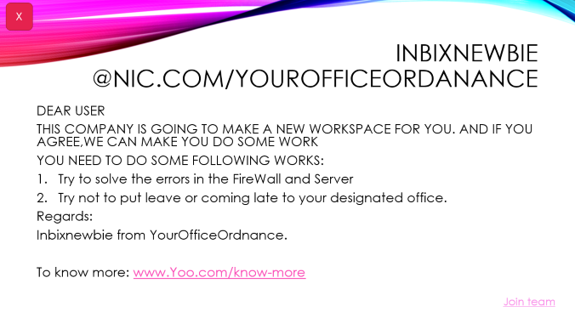
Will join?
Accept
Decline

Slide 3
INBIXNEWBIe @nic.com/yourofficeordanance
X
DEAR USER
THIS COMPANY IS GOING TO MAKE A NEW WORKSPACE FOR YOU. AND IF YOU AGREE,WE CAN MAKE YOU DO SOME WORK
YOU NEED TO DO SOME FOLLOWING WORKS:
Try to solve the errors in the FireWall and Server
Try not to put leave or coming late to your designated office.
Regards:
Inbixnewbie from YourOfficeOrdnance.
To know more: www.Yoo.com/know-more
Join team

Slide 4
Nointernetconnection offline mail con version 16.7990.65.72.01
Close
Compatible to windows infinity, ios 15, Android 11 and threshold reddify 16 pro.
Website to run online: nointernetconnectionmailservices.com
Theme
Dark
Light

Slide 5
Nointernetconnection offline mail con version 16.7990.65.72.01
Close
Compatible to windows infinity, ios 15, Android 11 and threshold reddify 16 pro.
Website to run online: nointernetconnectionmailservices.com
Theme
Dark
Light

Slide 6
INBIXNEWBIE @nic.com/hyundai
X
DEAR USER
THIS COMPANY IS GOING TO MAKE A NEW WORKSPACE FOR YOU. AND IF YOU AGREE,WE CAN MAKE YOU DO SOME WORK
YOU NEED TO DO SOME FOLLOWING WORKS:
HYUNDAI BLUE LINK
HYUNDAI YOUCONNECT
Regards:
Inbixnewbie from Hyundai ordnance.
To know more: www.hyundai.in
Join team

Slide 7
Will join?
Accept
Decline

Slide 8
Nointernetconnection.com
FullNointernetconnection offline mail con version 16.7990.65.7... information about this app.
INBIXNEWBE from Hyundai ordnance company
You are currently offline. Learn more
Archive

